Slide 1
West Nile Virus Prediction
Predict West Nile virus in mosquitos across the city of Chicago

Slide 2
Overview and Problem- Big

Slide 3
Dataset - Big

Slide 4
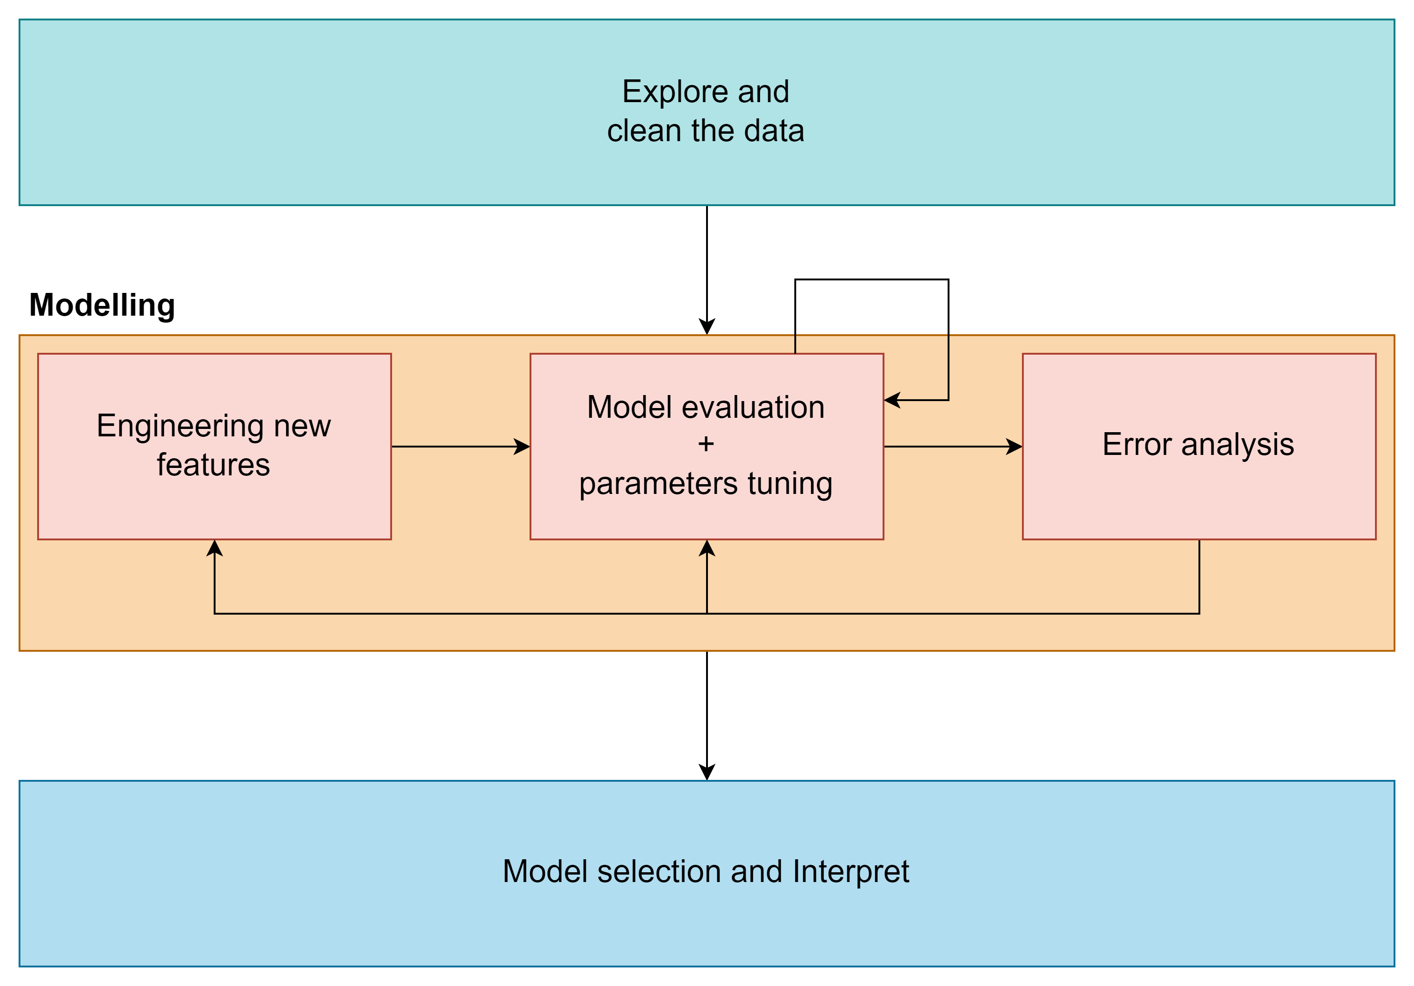
Process

Slide 5
EDA & Cleaning – P’A
Spray: unused with reasons
Weather
Drop correlated feature
Any cleaning ?
2 Stations distribution
Merge 2 station into average
Train
Data value correction
Distribution
Have virus vs no virus by species
Month with virus

Slide 6
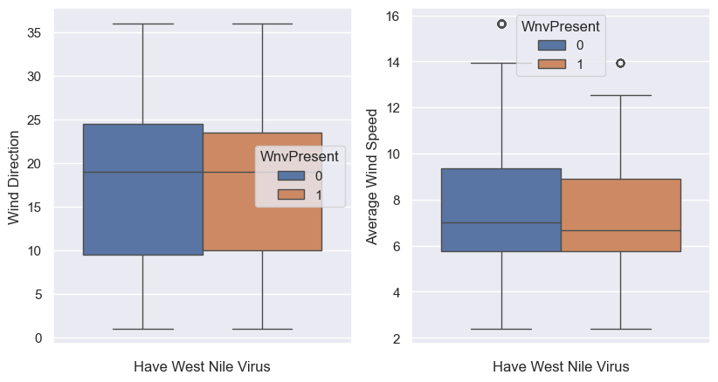
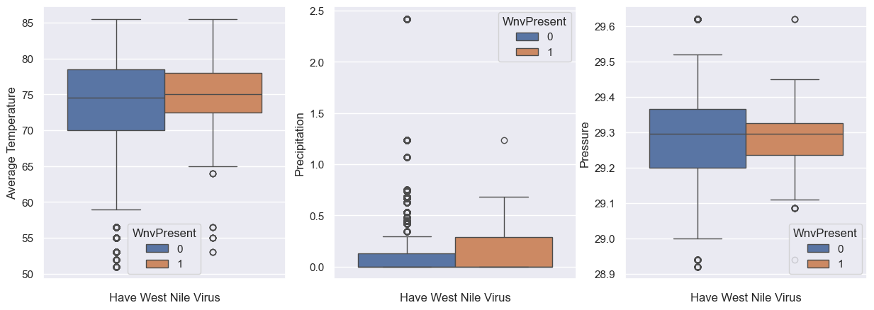
Feature Selection Weather
One that correlated with WNV
Average Temp.
Average Wind Speed
Uses moving average value

Slide 7
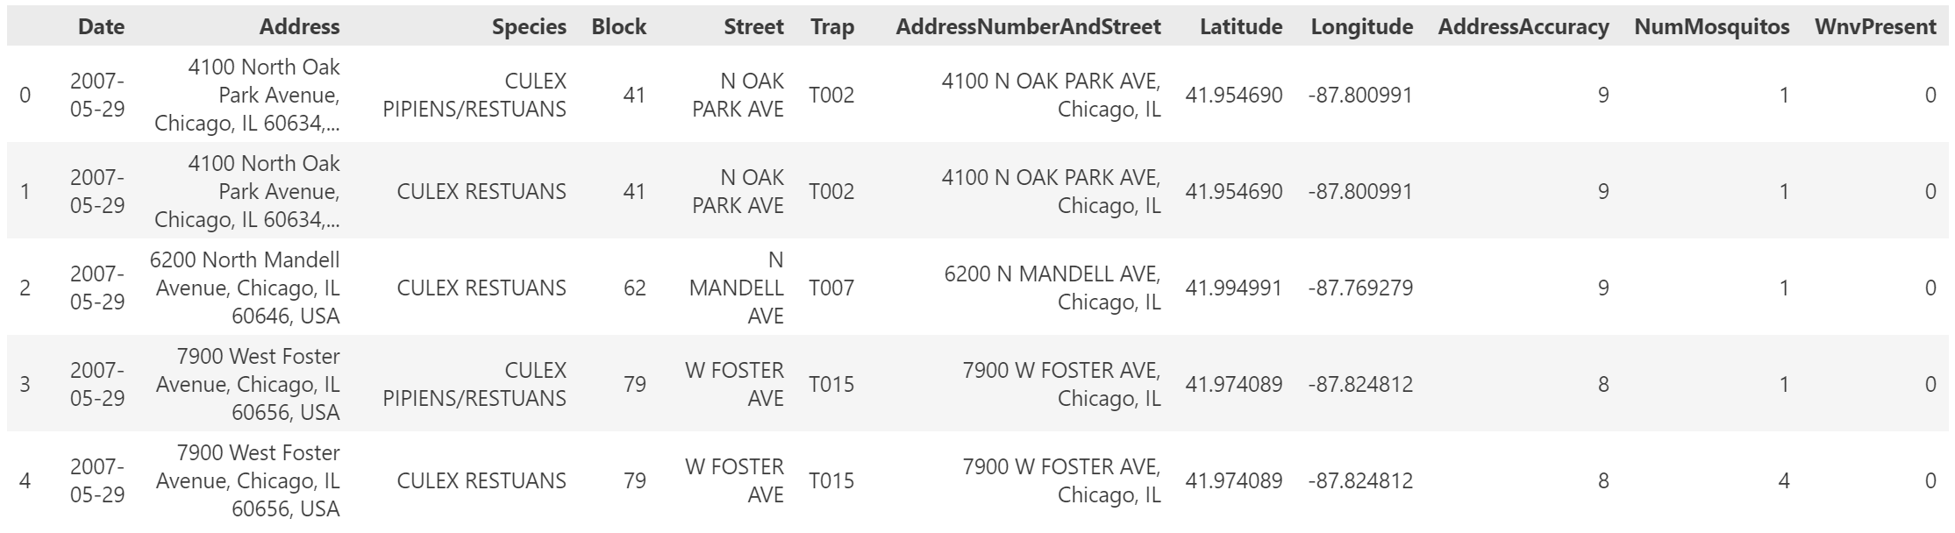
Feature Selection & Engineering Train data - Location and Time
Location
Latitude
Longitude
Time - Extract from date
Weeknum (week of year)
Year

Slide 8
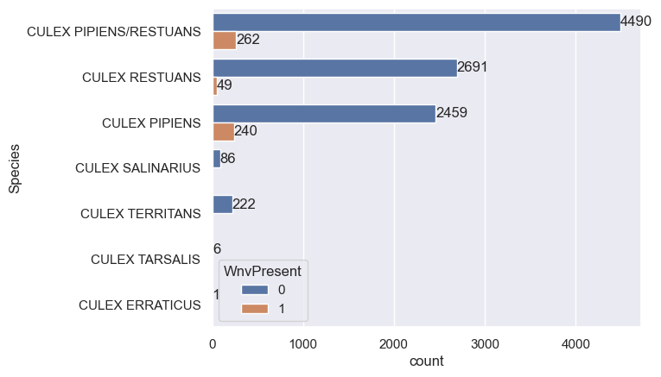
Feature Selection & Engineering Train data – Species

Slide 9
Feature Selection & Engineering Train data – Time related
The number of mosquitos missing in test data
Solution: Use records count instead
Difference of number of records from previous and current week

Slide 10
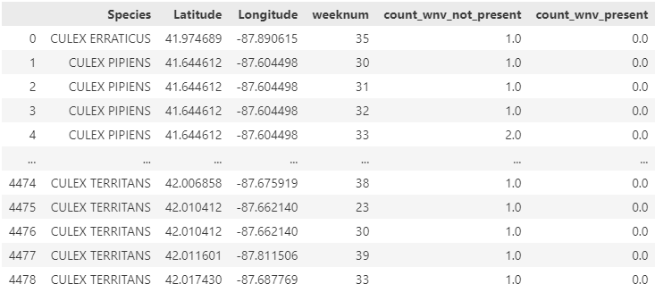
Feature Selection & Engineering Train data – West Nile virus presence proportion
Calculate the number of records by species, location (lat/long) and week of year
From the number of records, using the average number of records to calculate proportion

Slide 11
Model Selection - Big
Scoring method
Error analysis
Gridsearch
Selected model

Slide 12
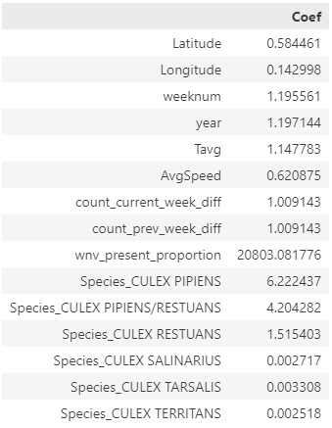
Summary & suggestion
Model for prediction – using XGBoost ?
Inference – using Linear Regression
Mosquitos control, cost effective suggestions

Slide 13
Model Limitation – P’A
Number of train data
Time period
Need periodically retrain ?
Species that model can predict, if there are any new species ?

